Slide 1
TO BATCH
OR NOT TO BATCH

Slide 2

MICHAEL MINELLA
Lead – Spring Batch &
Spring Cloud Task
JSR-352 - Expert Group Member
Author – Definitive Guide to SB
Speaker - JavaOne Rockstar
Java Champion
Podcast - OffHeap Curmudgeon
Twitter - @michaelminella or
@OffHeap

Slide 3


Slide 4
AVAILABLE
NOW!
https://www.apress.com/us/book/9781484237236

Slide 5

LAY OF THE LAND

Slide 6

SPRING FRAMEWORK

Slide 7

SPRING BATCH

Slide 8

SPRING INTEGRATION

Slide 9

ETL PROCESSING

Slide 10

STREAM PROCESSING

Slide 11

FUNCTIONS

Slide 12
¯\_(ツ)_/¯

Slide 13

LEAD SPRING BATCH
FOR NEARLY 8 YEARS

Slide 14






Slide 15

A LOT OF THE SAME
CONVERSATIONS

Slide 16
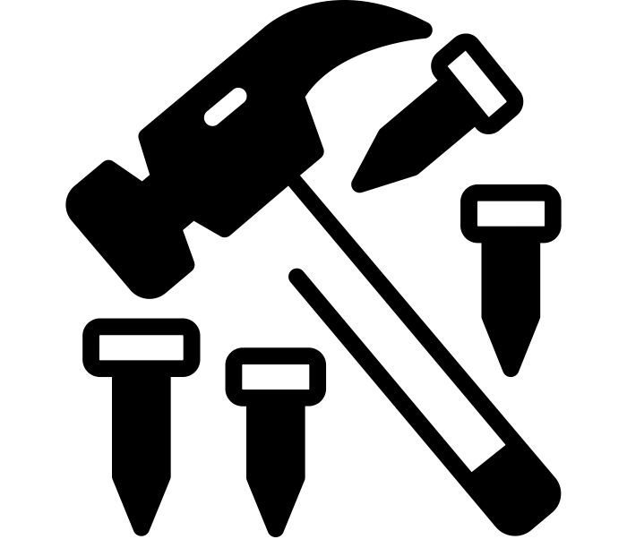
WHEN ALL YOU
HAVE IS A HAMMER
EVERYTHING
LOOKS LIKE A NAIL

Slide 17

RESUME DRIVEN
DEVELOPMENT

Slide 18

HAVE THOSE CONVERATIONS
WITH ALL OF YOU

Slide 19

MAKE SURE YOU
HAVE THE RIGHT
TOOL FOR THE JOB

Slide 20

INTERACTIVE
PRESENTATION

Slide 21
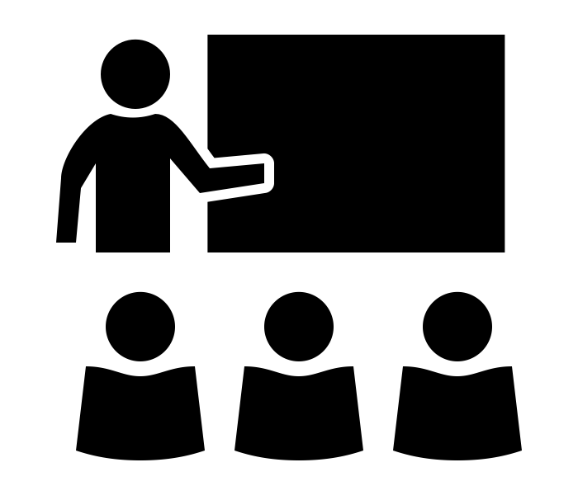
SPRING BATCH 101

Slide 22

WHEN DO I USE
SPRING BATCH?

Slide 23

WHEN DO I NOT USE
SPRING BATCH?

Slide 24

SPRING BATCH 101

Slide 25

WHAT IS BATCH
PROCESSING?

Slide 26
Batch processing, … is defined as the code my boss wrote before I was born and I’m now stuck with maintaining.
-- Nobody

Slide 27
Batch processing, … is defined as the processing of a finite amount of data without interaction or interruption
-- Michael Minella
The Definitive Guide to Spring Batch

Slide 28

LINGO

Slide 29

JOB

Slide 30
STEP

Slide 31


TASKLET VS CHUNK

Slide 32

ITEM

Slide 33
CHUNK

Slide 34
FLOW OF STEPS/COMPONENTS
STEP1
STEP2
STEP3
ItemReader
ItemReader
ItemReader
ItemProcessor
ItemProcessor
ItemProcessor
ItemWriter
ItemWriter
ItemWriter

Slide 35


Slide 36
ARCHITECTURE
ItemReader
JobLauncher
Job
Step
ItemProcessor
ItemWriter
JobRepository

Slide 39


Slide 40

HOW DO I MIGRATE
OFF OF BATCH?

Slide 41

TL;DR; YOU
PROBABLY DON’T

Slide 42

THERE ARE MANY WAYS
TO SOLVE ANY PROBLEM

Slide 43
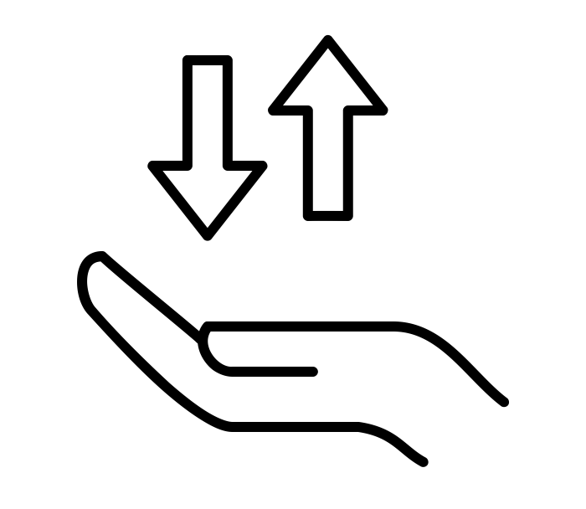
THIS IS ABOUT
MAKING TRADE OFFS

Slide 44
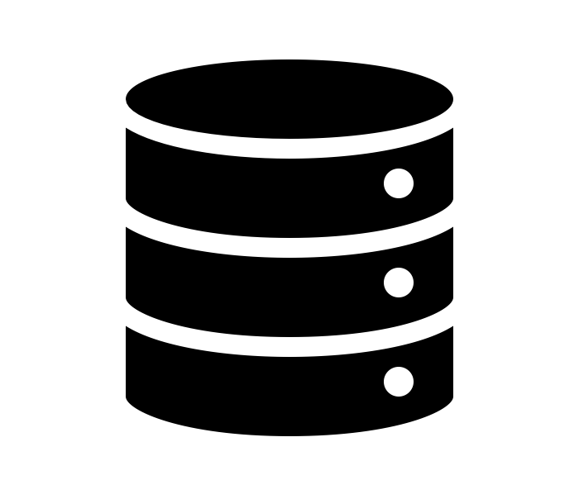
TYPES OF DATA

Slide 45

LONG LIVED
FINITE

Slide 46

WHAT HAPPENS WHEN
THINGS GO WRONG?

Slide 47

LET’S THINK ABOUT
A USE CASE

Slide 48



CSV Input Files
Import Process

Slide 49
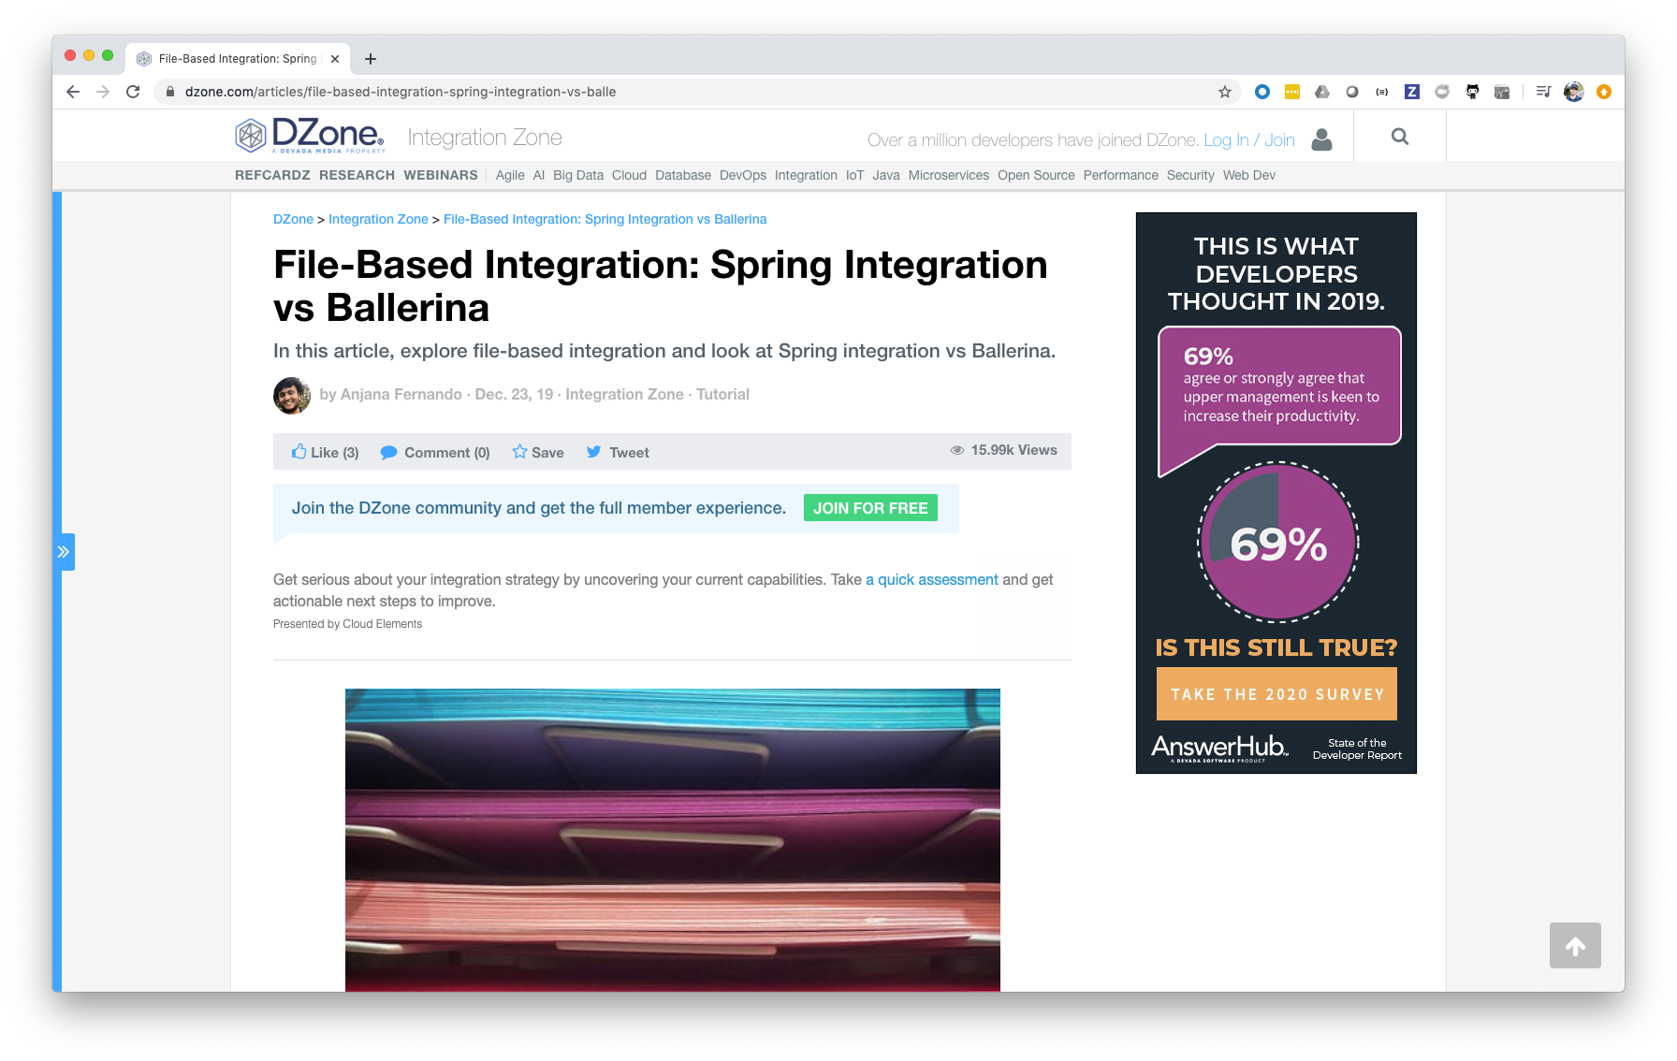
Notes:
https://dzone.com/articles/file-based-integration-spring-integration-vs-balle
Article is based on a Spring Integration sample application found here: https://github.com/spring-projects/spring-integration-samples/tree/master/applications/file-split-ftp

Slide 50


Slide 51
XML Input Files
Import Process

Slide 52
Monolithic app with
Spring Integration
Import Process
Notes:
Single SI Flow:
When do we run it? – Most likely deployment option will be leaving it running 24/7 wasting resources
What kind of data is being processed? – A finite amount (a file)
What happens when things go wrong? – It’s harder…the SI documentation flat out says it https://docs.spring.io/spring-integration/reference/html/error-handling.html
SI has retry capabilities
Transactions are bound to a given thread…typically not how integration applications are built
Need to write custom logic to handle skip/restart/etc
How do we scale? – Scale the entire world
Complex development model

Slide 53
Microservices with
Spring Cloud Stream
or a FaaS
File Source
Database Sink
Transformer
Notes:
Spring Cloud Stream/Spring Cloud Function:
When do we run it? – Most likely deployment option will be leaving it running 24/7 wasting resources
What kind of data is being processed? – A finite amount (a file)
What happens when things go wrong?
SI has retry capabilities
Transactions across microservices is a non-starter
Need to write custom logic to handle skip/restart/etc
How do we scale? – this gets better
Data integrity is dependent upon resilient middleware
Serialization costs between microservices
Orchestration needs for complex flows

Slide 54
Batch Application
Import Process
Notes:
Single SI Flow:
When do we run it? – On demand. When the file is sent
What kind of data is being processed? – A finite amount (a file)
What happens when things go wrong?
Batch has integrated skip, retry, start, restart, etc
Transactionality is baked into the framework
How do we scale? – various options
Simple, Spring friendly development model

Slide 55
TO BATCH
OR NOT TO BATCH?

Slide 56
WE BATCH!

Slide 57
LET’S THINK ABOUT
ANOTHER USE CASE

Slide 58

ClickService
AnalysisService
Kafka

Slide 59
Monolithic app with
Spring Integration
ClickApplication
Kafka

Slide 60
Microservices with
Spring Cloud Stream
or a FaaS
ClickService
AnalysisService
Kafka

Slide 61
Batch Application
ClickService
AnalysisBatchService
Kafka

Slide 62
TO BATCH
OR NOT TO BATCH?

Slide 63
WE DO NOT BATCH!

Slide 64
THERE ARE MANY WAYS
TO SOLVE ANY PROBLEM

Slide 65
THIS IS ABOUT
MAKING TRADE OFFS

Slide 66
TYPES OF DATA

Slide 67
LONG LIVED
FINITE

Slide 68
WHAT HAPPENS WHEN
THINGS GO WRONG?

